Slide 1
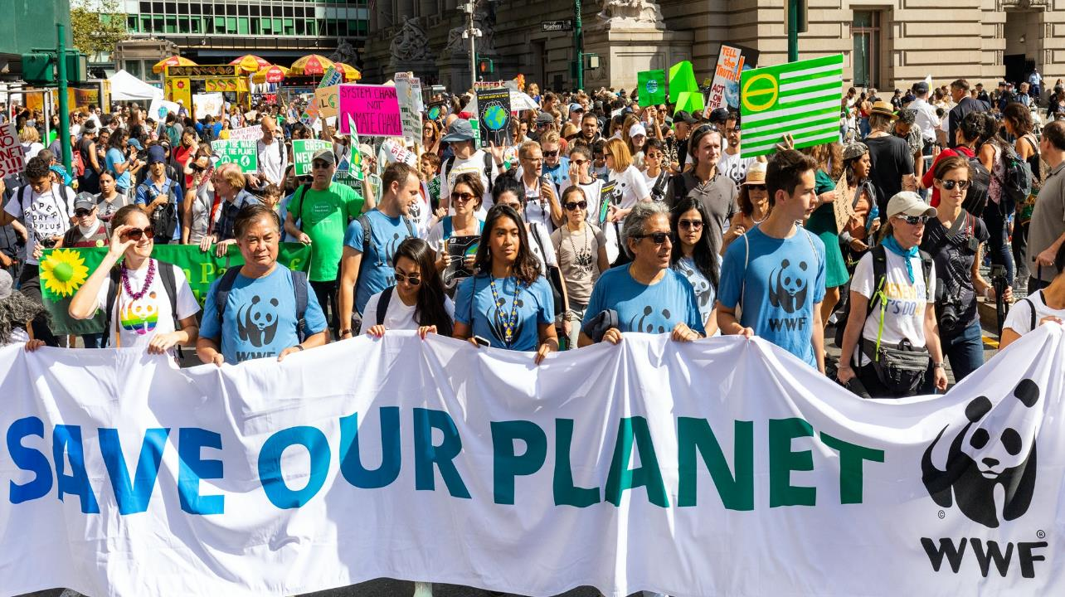
Understanding Climate Change
© Keith Arnold/ WWF-UK
Notes:
Lesson plan with timings can be found here: Climate Change Literacy - Lesson Plan - Assembly.docx

Slide 2
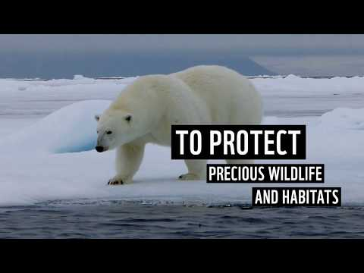
Who we are: WWF
Notes:
Play video – an introduction to WWF
https://vimeo.com/385956974/3b274d03d5

Slide 3
©SabinaMcKenzieBrown/ShoutOutUK
Shout Out UK: The voice of the next generation
Shout Out UK is a youth-led education network that aims to engage young people in political life through a Political and Media Literacy Programme, and an E-learning platform that helps schools across the UK implement democracy on school level.
Notes:
Introduction to Shout Out UK

Slide 4
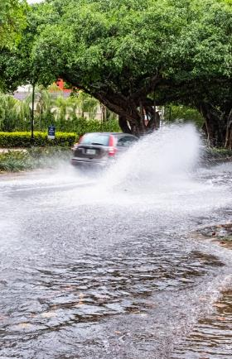
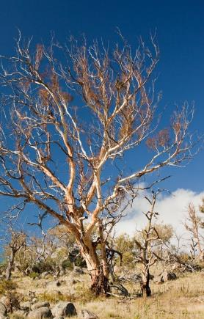
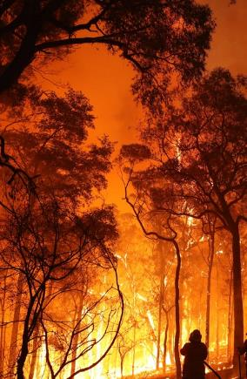
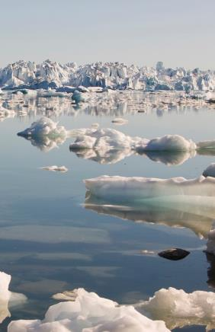
What are these images showing?
© Jason Houston / WWF-US
© Global Warming Images / WWF
© Rohan Kelly / Newspix
© Global Warming Images / WWF
What could be making these events more extreme?
Notes:
In order to grasp the concept of climate change, students need to understand the distinction between weather and climate.
Weather is what you see outside on any particular day. This includes temperature, rainfall and wind.
Climate is a description of the long-term pattern of weather in a particular area. Variables that are commonly measured are temperature, humidity, atmospheric pressure, wind, and precipitation.

Slide 5
Climate Change!
© Jason Houston / WWF-US
© Global Warming Images / WWF
© Rohan Kelly / Newspix
© Global Warming Images / WWF
Notes:
Ask if anyone knows what is meant by climate change.
Climate change is a long-term shift in global or regional climate patterns.
Global warming refers specifically to the rise in global temperatures that leads to climate change.
Ask what is happening in each photo. (Flooding, drought, forest fires, melting ice caps)
Ask what could be making these events more extreme? (Climate change)
Further Notes.
These weather events occur naturally but climate change is making them more extreme in terms of frequency and ferocity. This has impacts on livelihoods, landscapes and nature.

Slide 6
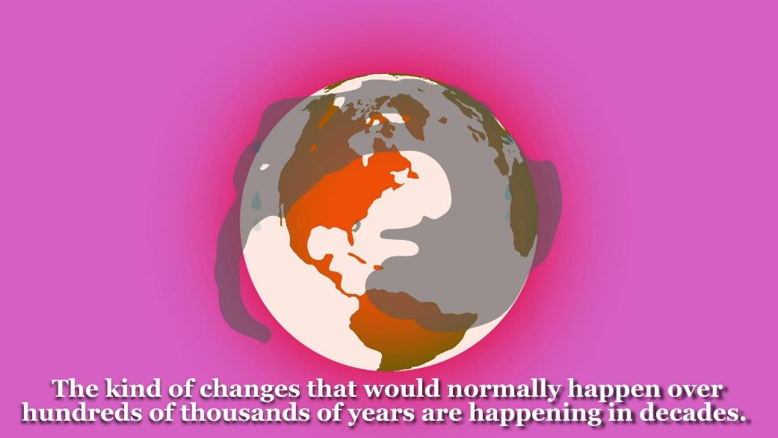
Myth busting animation will be here
Notes:
You can access the Myth Busting video here: https://vimeo.com/424755522/1485ec2701

Slide 7
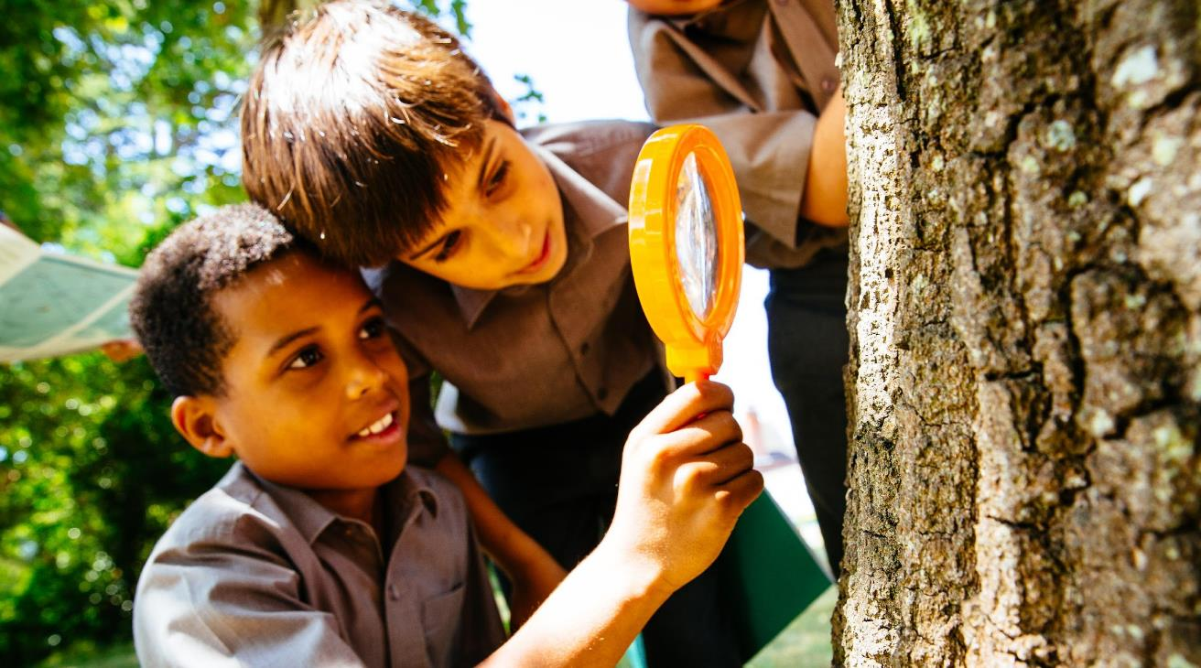
What can you do to help?
1. Reduce your carbon footprint.
2. Help your family live a greener lifestyle
© Greg Armfield / WWF-UK
Notes:
There are 2 things students can focus on to help combat climate change. Read slide.

Slide 8
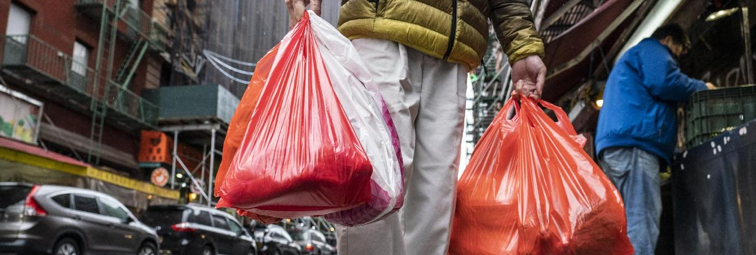
What is the problem?
What is the problem?
© Getty Images
We have a ‘throw away’ culture.
We like to buy new things and things we don’t need.
As much as 80% of the things we throw away could be recycled.
Notes:
Read slide.
If time allows: Ask students why this could be a problem.

Slide 9
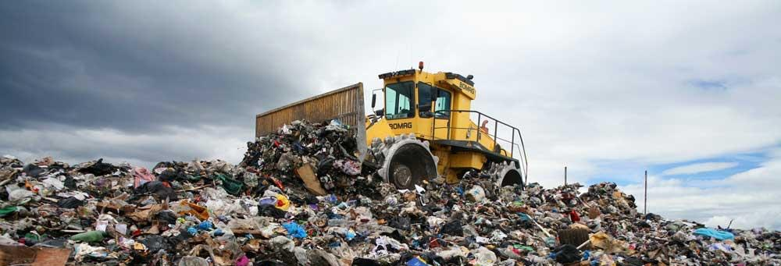
Why is this a problem?
Why is this a problem?
Tractor at a landfill site © Steve Morgan / WWF-UK
By over using resources we increase our carbon footprint.
We use more energy and materials to keep up with demand for new products.
Two thirds of landfill waste releases methane gas (a GHG) as it decomposes.
Notes:
Read slide.
Further Notes.
A huge 91% of plastic is not recycled - much of this ends up on landfill sites - this can take up to 1,000 years to decompose!
Ask students what they could do to help solve this problem. (Examples on the next slide).

Slide 10
How can you help?
Reduce consumption and chose reusables.
Buy a reusable water bottle!
Say no to plastic cutlery!
Buy second hand
instead of brand new.
Stop using straws!
They can take 300 years to decompose!
Take a fabric bag
when you shop.
©kondratya/shutterstock
Think before you buy –
do you really need it?
Notes:
Read out any examples not already covered. Not just about plastic!
Other examples:
Ditching plastic straws / Use beeswax wrap rather than cling wrap
Use plastic free tea bags / Host a clothes swap

Slide 11
How can you help?
Buy sustainable and recyclable products.
Wood is FSC certified
Made from recycled plastics and aluminium
Airpods are glued together so cannot be fixed.
They cannot be easily recycled because of the lithium battery inside.
©HouseofMarley
Every purchase of Liberate Air contributes to the planting of trees through donations to their partner organisation, One Tree Planted.
Notes:
If time is limited, refer to slide and make the point about choosing sustainable products.
Case study: Choosing sustainable products.
Ask students to show hands if they own a pair of airpods. What do they think the environmental impacts of these are?
Introduce them to the following facts about how airpods are a disaster for the environment:
They can’t be easily recycled, because there is no safe way to separate the lithium-ion battery from the plastic shell.
They can’t be repaired because they are glued together.
Now compare them to the sustainable headphones on the slide (Liberate Air, produced by The House of Marley). Rhetorical question: Would students be willing to make the swap to the more sustainable option?

Slide 12
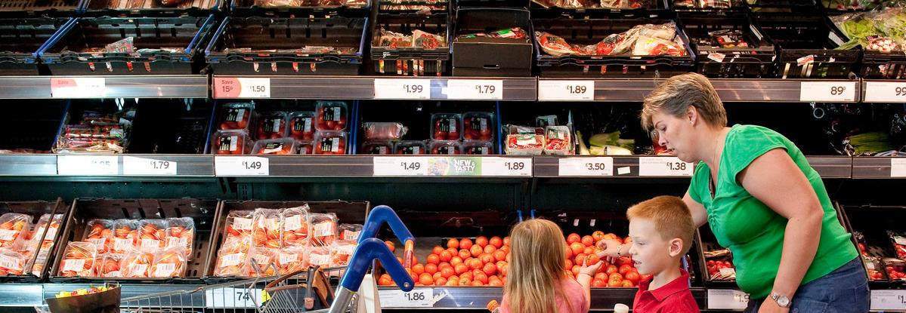
What is the problem?
What is the problem?
© WWF / Richard Stonehouse
We waste too much food.
UK households throw away 7 million tonnes of food/drink every year.
This includes 50 million chickens being thrown away, and 100 million pints of milk poured down the drain!
Globally one third of all food produced is either lost or wasted,
Notes:
Read slide.
If time allows: Ask students why this could be a problem. (Examples on the next slide).

Slide 13
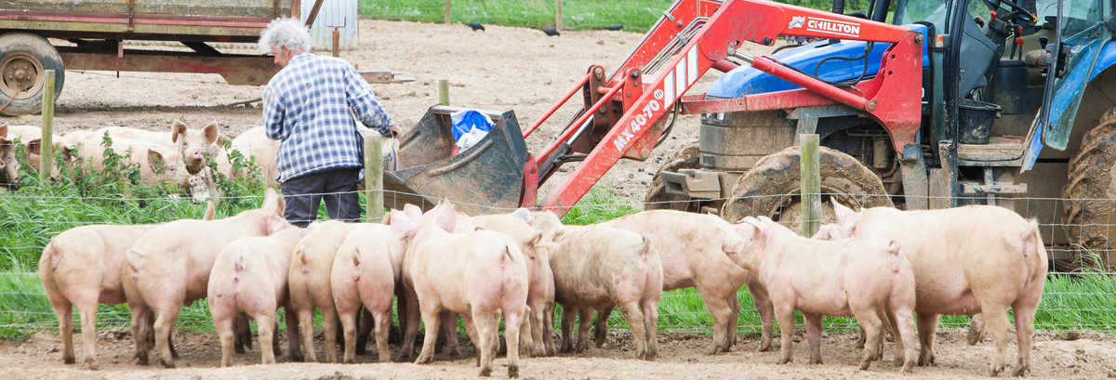
Why is this a problem?
problem?
© Global Warming Images / WWF
Food production releases greenhouse gases:
Agriculture (land conversion, deforestation, methane from cattle).
The supply chain (transportation, packaging).
Consumption (consumer travel and food preparation).
Notes:
Examples given.
Further Notes.
When food is disposed of in a landfill it rots and becomes a significant source of methane, a greenhouse gas.
Ask students what they could do to help solve this problem. (Examples on the next slide).

Slide 14
How can you help?
Waste less! Only buy what you need and embrace leftovers!
Buy locally produced food to reduce carbon footprint.
Eat less meat and eat more plant based meals.
Download the Giki app!
Look out for the MSC label on seafood, the Fairtrade logo, and RSPO for sustainable palm oil
Notes:
Read out any examples not already covered.
Other examples:
Buy and cook what you need / Grow your own
Further Notes.
Giki app: The Giki app explores the environmental impact of their UK supermarket products to help them make more informed choices when buying food - https://www.wwf.org.uk/updates/palm-your-hands

Slide 15
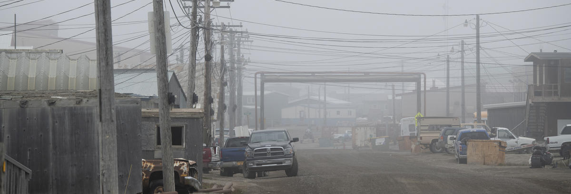
What is the problem?
What is the problem?
©Chris Linder / WWF-US
We use too much energy and natural resources.
Global energy demand increased by 56% from 1990 to 2014.
Over the last decade demand for water has grown at more than twice the rate of population increase.
Demand for wood is expected to triple by 2050, primarily because of growing demand for timber, paper and bioenergy.
Notes:
Read slide.
If time allows:
Ask students why this could be a problem. (Examples on the next slide).
Energy waste: Ask students for examples of energy use in their daily lives: examples include charging phones, tablets and laptops; watching tv; playing video games; cooking; their journey to schools; taking a shower.

Slide 16
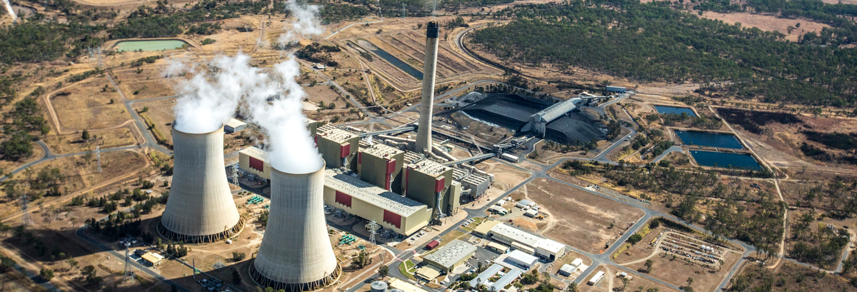
Why is this a problem?
problem?
© WWF / James Morgan
This is contributing to climate change.
Burning fossil fuels for energy (oil, coal, gas), emits greenhouse gases. Globally, 33% of all emissions are related to electricity and heat production whilst 15% comes from transportation.
It's estimated that over 15 billion trees are cut down each year. Trees are a vital source of carbon storage.
Notes:
Examples given.
Ask students what they could do to help solve this problem. (Examples on the next slide).

Slide 17
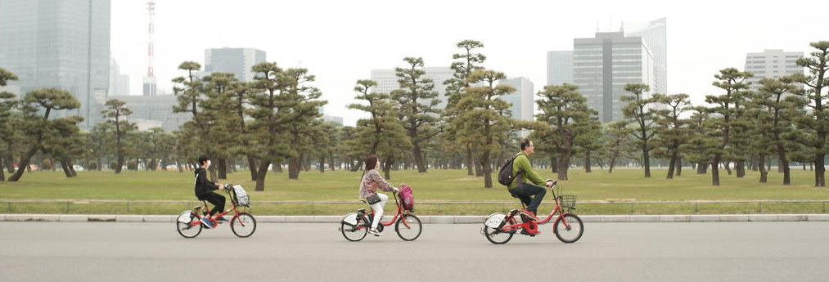
How can you help?
How can you help?
© Cahya Anggriawan / PIXERF / WWF
Be energy efficient!
Turn of all appliances at the sockets when not in use and don’t leave them on standby
Take shorter showers
Walk, cycle or take public transport instead of taking the car
Notes:
Read out any examples not already covered.
Further Notes.
Turn off appliances - This reduces electricity consumption.
Take shorter showers - cutting down the time you take in the shower will reduce the amount of energy needed to heat the water, as well as contributing to water conservation.
Public transport – reduces fuel consumption and amount of greenhouse gasses emitted from exhaust fumes.

Slide 18
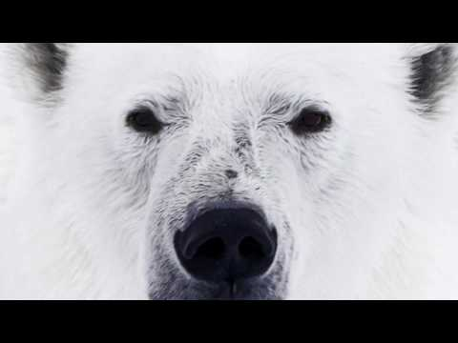
Notes:
Play WWF ‘Fight for your world’ video.
https://www.youtube.com/watch?v=pBmLPcvTUHw&feature=youtu.be

Slide 19
What is your first step to becoming
more environmentally friendly?
© Frank Parhizgar / WWF- Canda
Notes:
Finish by reading out this question and asking students to go away and think about what they can do in their own lives.
If time allows: Ask students to share ideas.

